Slide 1
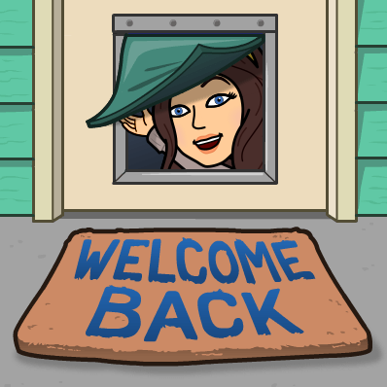
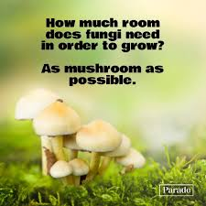
WElcome to Physical Science-
Week 10:Monday
Today’s Agenda:
Culture and Community week- day 1
Formative Practice:
Warm up: Grab a sticky note from the front. On it, draw what a scientist looks like.
Learning Target: I can explain the importance of representation and diversity in science and talk about a wide range of scientists.

Slide 2
Solo REading
Jot down 3 key things/definitions on your warm up sheet as you read silently.

Slide 3
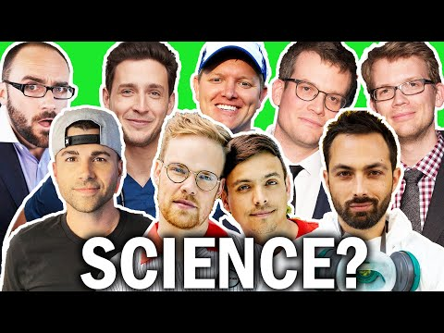
Watch- respectfully!- and jot down anything they say that surprised or resonates with you

Slide 4
Reflection Write
On a blank piece of paper, answer at least 3/5
How does talking about representation make you feel? What does ‘Diversity’ mean?
Why is diversity in science important?
Why do you think science has been so historically white? How have you seen or not seen this?
What can we do to bring more ideas/perspectives/diversity into science?
What questions do you have that you want to explore or answer?
Why is it important to celebrate everyone?

Slide 5
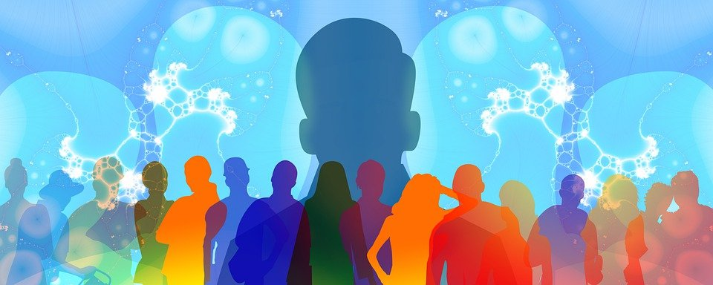
Representation in Science Poster Project
Choose a scientist who interests you (See links from Mrs. P for ideas!)
Research Them!
2 + MLA Sources, put source on back
-Name
-Important background or identity information for them
-A short summary of what they do in the scientific community
-Highlight any barriers/challenges they have had to deal with or overcome during their time in science
Make a Poster!
-A visual representation of them and/or their work
-The information you found in Requirement 2.
-Be neat and organized- easy for another budding scientist to understand!
Notes:
https://docs.google.com/document/d/1UlId47mvHKLkEYSeWSHqgU4f1rHBWTUBL-mfo7Kfn1M/edit?usp=sharing

Slide 6
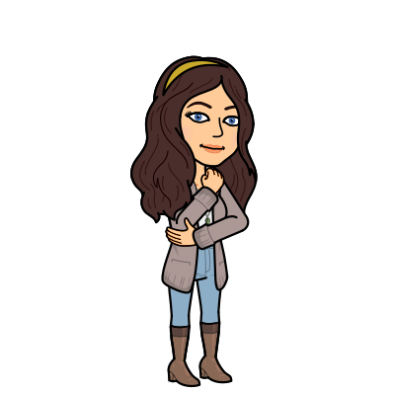
Reminders For Next Class
Today’s Agenda:
-Formative Practice:
How do you feel on this LT?
No clue
Some clue
Mostly got it
Nailed it
Learning Target:I can explain the importance of representation and diversity in science and talk about a wide range of scientists.
0
1
2
3

Slide 7
WElcome to Physical Science-
Week 10-Tuesday
Today’s Agenda:
Community and culture- representation posters
Formative Practice: Poster due at start of class tomorrow!
Warm up: What do you think are valuable skills or abilities a good scientist must have? List at least 5
Learning Target: I can explain the importance of representation and diversity in science and talk about a wide range of scientists.

Slide 8
Representation in Science Poster Project
Choose a scientist who interests you (See links from Mrs. P for ideas!)
Research Them!
2 + MLA Sources, put source on back
-Name
-Important background or identity information for them
-A short summary of what they do in the scientific community
-Highlight any barriers/challenges they have had to deal with or overcome during their time in science
Make a Poster!
-A visual representation of them and/or their work
-The information you found in Requirement 2.
-Be neat and organized- easy for another budding scientist to understand!
Notes:
https://docs.google.com/document/d/1UlId47mvHKLkEYSeWSHqgU4f1rHBWTUBL-mfo7Kfn1M/edit?usp=sharing

Slide 9
RUBRIC
 | 4 | 3 | 2 | 1
Visual Representation | Scientist and their work is represented visually on the poster, and is large enough to catch attention | Scientist or their work is represented visually on the poster, and is large enough to catch attention | Scientist or their work is represented visually on the poster. | Scientist or their work is not represented visually on the poster.
Information | All 4 information requirements are present in the poster design and are correct | 3 information requirements are present in the poster design and are correct | 1-2 information requirements are present in the poster design and are correct | Some information requirements are present in the poster design and are incorrect
Citrations | 2+ citations are supplied on the back of the poster and are formatted correctly in MLA style | 2+ citations are supplied on the back of the poster with some (MLA) formatting mistakes | Less than 2 citations are supplied on the back of the poster and are formatted correctly in MLA style | Less than 2 citations are supplied on the back of the poster with some (MLA) formatting mistakes
Organization | Poster is neat and organized in a way that makes it easy to read and visually pleasing | Poster is mostly neat and organized in a way that makes it readable | Poster is lacking organization and neatness in a way that makes it hard to read. | Poster cannot be read or understood.
Respect | Both Student and poster always display respectful attitudes when discussion aspects of diversity and representation in science | Both Student and poster usually display respectful attitudes when discussion aspects of diversity and representation in science | Student or poster does not display respectful attitudes when discussion aspects of diversity and representation in science | Student and poster does not display respectful attitudes when discussion aspects of diversity and representation in science

Slide 10
Reminders For Next Class
Today’s Agenda:
-Formative Practice:
Poster due tomorrow at start of class-submit to schoology or bring in hard copy
-citations must be ON the poster
How do you feel on this LT?
No clue
Some clue
Mostly got it
Nailed it
Learning Target: I can explain the importance of representation and diversity in science and talk about a wide range of scientists.
0
1
2
3

Slide 11
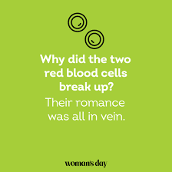
WElcome to Physical Science-
Week 10-Wednesday
Today’s Agenda:
Class Compliments
Identity Wheels
Formative Practice:
Warm up: Get out your poster and leave it flat on your desk. Poster Gallery walk!
Learning Target: I can explain the importance of representation and diversity in science and talk about a wide range of scientists.

Slide 12
Class Compliments
GOAL: By the end of the week, have at least 1-2 compliments per person in the class. These compliments need to be deeper than surface level.
Examples:
❌ You are pretty
✔️ You always take the time to say hi and that means a lot
❌ I like your backpack
✔️ Your smile lights up the room
❌ You aren’t annoying
✔️ You bring great energy and questions to class
You will have some time to compile this list throughout the week, and you will turn your completed page into your teacher at the end of the week. Then, you will receive the compliments written to you to start your next week off right!
WHY? Studies have shown that appreciation and gratitude are key to building a strong community, and they improve your happiness and relationships long term. We are working to build a strong classroom community, so recognizing the strengths, passions, and contributions of each person in this class is integral to creating a strong community. It also ensures you know the names of everyone in your community, which is also vital!

Slide 13
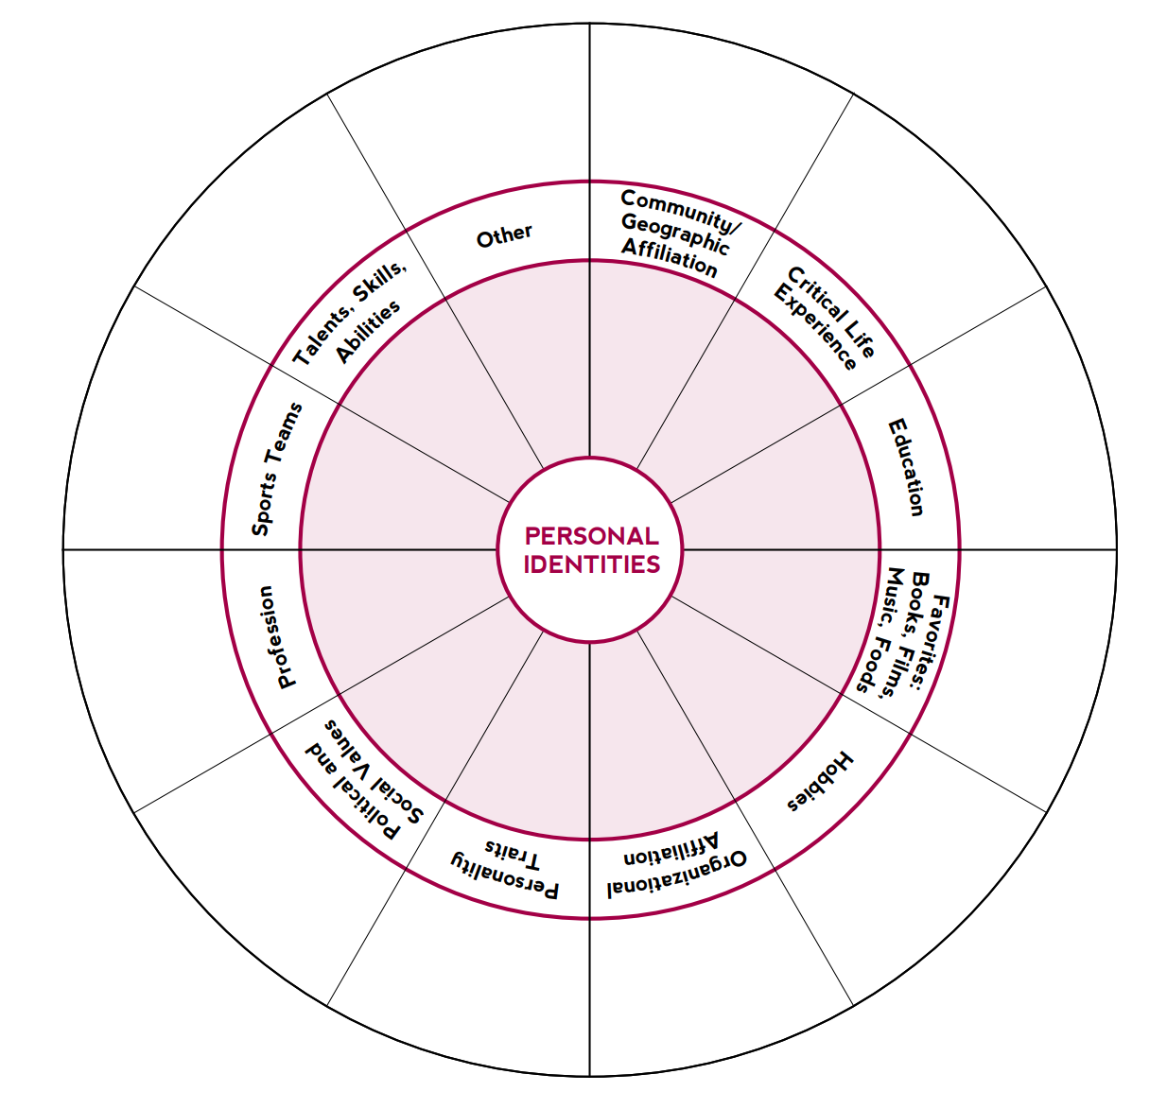
Personal Identity wheel
Fill in your identity for each of the categories listed. In the inner circle, record the identities that are the most important or salient to you. In the outer circle, record the identities that are less important or salient to you.

Slide 14
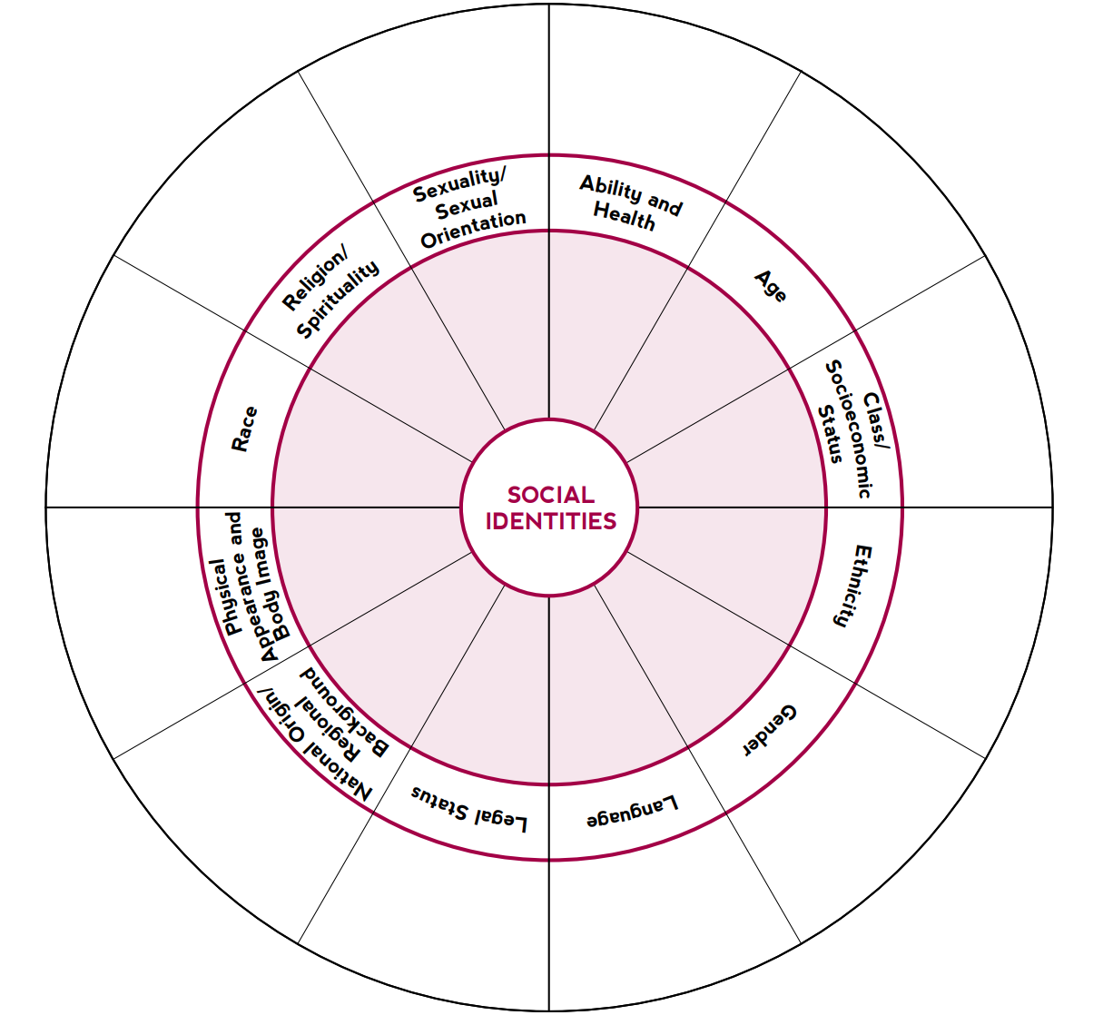
Social Identity wheel
Fill in your identity for each of the categories listed. In the inner circle, record the identities that are the most important or salient to you. In the outer circle, record the identities that are less important or salient to you.

Slide 15
Reflection
Answer the following 5 reflection questions.
Remember, this is about you and you only. Everyone’s identities are unique and reflect differently in your lives.

Slide 16
Reminders For Next Class
Today’s Agenda:
Inside the earth
-Formative Practice:
How do you feel on this LT?
No clue
Some clue
Mostly got it
Nailed it
Learning Target: I can explain the importance of representation and diversity in science and talk about a wide range of scientists.
0
1
2
3

Slide 17
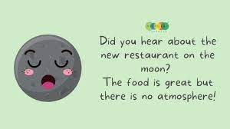
WElcome to Physical Science-
Week 10-Thursday
Today’s Agenda:
Class Compliments
Class Norms Brainstorm
Drawing Twins Game
Formative Practice:
Warm up: Class Compliments time- 5 minutes (silently and individually)
Learning Target:I can explain the importance of representation and diversity in science and talk about a wide range of scientists.

Slide 18
Class Compliments
GOAL: By the end of the week, have at least 1-2 compliments per person in the class. These compliments need to be deeper than surface level.
Examples:
❌ You are pretty
✔️ You always take the time to say hi and that means a lot
❌ I like your backpack
✔️ Your smile lights up the room
❌ You aren’t annoying
✔️ You bring great energy and questions to class
You will have some time to compile this list throughout the week, and you will turn your completed page into your teacher at the end of the week. Then, you will receive the compliments written to you to start your next week off right!
WHY? Studies have shown that appreciation and gratitude are key to building a strong community, and they improve your happiness and relationships long term. We are working to build a strong classroom community, so recognizing the strengths, passions, and contributions of each person in this class is integral to creating a strong community. It also ensures you know the names of everyone in your community, which is also vital!

Slide 19
On your own (write down your answers)-5 minutes
What is important to you to feel safe in a class environment?
What is important to you to feel comfortable in a class environment?
What is important to you to feel brave in a class environment?
What are the top 5 values our class should have?
What are the top 3 actions each person in our class should take to demonstrate our values?
What is 1 guideline/routine we can have as a class to remind ourselves and others when we get off track and away from these values and behaviors?
Now, discuss with your table group- 4 minutes- Be Prepared to share out!

Slide 20
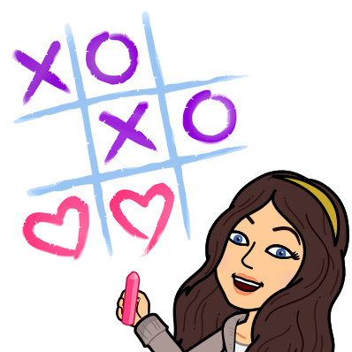
Drawing Twins Game
Grab a piece of paper and a writing utensil
Find a partner and find a spot for yourselves. One person should be facing the front screen, the other should be facing away from it.
The person facing the screen is the ‘Describer’, and the person facing away is the ‘Scribe’
YOUR TASK: the ‘Describer’ will give instructions to the ‘Scribe’ on how to draw the picture they see on the screen.

Slide 21
Drawing Twins Game:
Part 1: Describer can see what the scribe is drawing while they draw it, scribe can ask questions
Part 2: Describer cannot see what the scribe is drawing, Scribe can ask questions
Brainstorm: What Keys to success do you need for part 3?
Part 3: Describer cannot see what the scribe is drawing, scribe cannot ask questions

Slide 22
Part 1

Slide 23
Drawing Twins Game:
Part 1: Describer can see what the scribe is drawing while they draw it, scribe can ask questions
Part 2: Describer cannot see what the scribe is drawing, Scribe can ask questions
Brainstorm: What Keys to success do you need for part 3?
Part 3: Describer cannot see what the scribe is drawing, scribe cannot ask questions

Slide 24
Part 2.

Slide 25
Drawing Twins Game:
Part 1: Describer can see what the scribe is drawing while they draw it, scribe can ask questions
Part 2: Describer cannot see what the scribe is drawing, Scribe can ask questions
Brainstorm: What Keys to success do you need for part 3?
Part 3: Describer cannot see what the scribe is drawing, scribe cannot ask questions

Slide 26
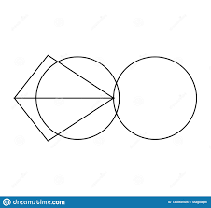
Part 3

Slide 27
Debrief - Think, Pair, Share
What are your Key Takeaways?
What were the Barriers to effective cooperation?
Why is cooperation and communication important in science?
How can we make sure to communicate clearly even when frustrated?
Notes:
If needed: additional activity: What do we know about the science of Covid-Think, pain, share

Slide 28
Class Compliments
GOAL: By the end of the week, have at least 1-2 compliments per person in the class. These compliments need to be deeper than surface level.
Examples:
❌ You are pretty
✔️ You always take the time to say hi and that means a lot
❌ I like your backpack
✔️ Your smile lights up the room
❌ You aren’t annoying
✔️ You bring great energy and questions to class
You will have some time to compile this list throughout the week, and you will turn your completed page into your teacher at the end of the week. Then, you will receive the compliments written to you to start your next week off right!
WHY? Studies have shown that appreciation and gratitude are key to building a strong community, and they improve your happiness and relationships long term. We are working to build a strong classroom community, so recognizing the strengths, passions, and contributions of each person in this class is integral to creating a strong community. It also ensures you know the names of everyone in your community, which is also vital!

Slide 29
Reminders For Next Class
Today’s Agenda:
-Formative Practice:
How do you feel on this LT?
No clue
Some clue
Mostly got it
Nailed it
Learning Target: I can explain the importance of representation and diversity in science and talk about a wide range of scientists.
0
1
2
3

Slide 30
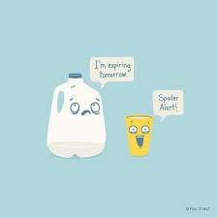
WElcome to Physical Science-
Week 10-Friday
Today’s Agenda:
Games
Class Compliments
Formative Practice: Enjoy the weekend!
Warm up: Class Compliments
Learning Target: I can explain the importance of representation and diversity in science and talk about a wide range of scientists.

Slide 31
Class Compliments
GOAL: By the end of the week, have at least 1-2 compliments per person in the class. These compliments need to be deeper than surface level.
Examples:
❌ You are pretty
✔️ You always take the time to say hi and that means a lot
❌ I like your backpack
✔️ Your smile lights up the room
❌ You aren’t annoying
✔️ You bring great energy and questions to class
You will have some time to compile this list throughout the week, and you will turn your completed page into your teacher at the end of the week. Then, you will receive the compliments written to you to start your next week off right!
WHY? Studies have shown that appreciation and gratitude are key to building a strong community, and they improve your happiness and relationships long term. We are working to build a strong classroom community, so recognizing the strengths, passions, and contributions of each person in this class is integral to creating a strong community. It also ensures you know the names of everyone in your community, which is also vital!

Slide 32
Cheer War- Rock, Paper, Scissors
Play rock paper scissors
If you lose, you are now the cheering squad for the person who won.You must cheer loudly and enthusiastically!
If you win, find someone else to go battle

Slide 33
No Hands Cup Stacking!
Stack the cups into a pyramid without touching them

Slide 34
Spaghetti Tower
Construct the tallest tower you can from the materials you have in 10 minutes

Slide 35
Complete your …Class Compliments
GOAL: By the end of the week, have at least 1-2 compliments per person in the class. These compliments need to be deeper than surface level.
Examples:
❌ You are pretty
✔️ You always take the time to say hi and that means a lot
❌ I like your backpack
✔️ Your smile lights up the room
❌ You aren’t annoying
✔️ You bring great energy and questions to class
You will have some time to compile this list throughout the week, and you will turn your completed page into your teacher at the end of the week. Then, you will receive the compliments written to you to start your next week off right!
WHY? Studies have shown that appreciation and gratitude are key to building a strong community, and they improve your happiness and relationships long term. We are working to build a strong classroom community, so recognizing the strengths, passions, and contributions of each person in this class is integral to creating a strong community. It also ensures you know the names of everyone in your community, which is also vital!

Slide 36
Reminders For Next Class
Today’s Agenda:
-Formative Practice:
Have a good weekend!
How do you feel on this LT?
Learning Target: I can explain the importance of representation and diversity in science and talk about a wide range of scientists.
No clue
Some clue
Mostly got it
Nailed it
0
1
2
3

